Slide 1

Swimming Pool

Slide 2



Content
Programs/languages we used in the project
Resume
Pros and Cons
How we did it ?
Future plans

Slide 3


Programs/languages we used in the project
C++
Visual Studio 2019 IDE

Slide 4
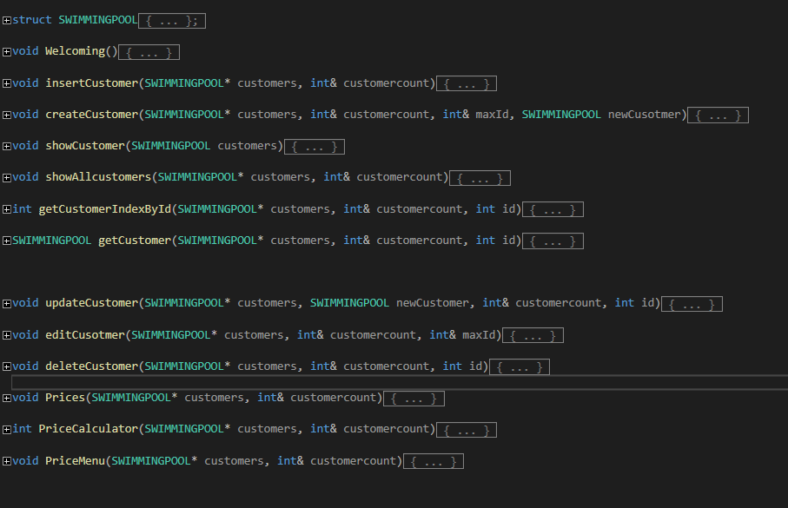
Resume
Our computer program has features for adding, displaying, editing, deleting and showing clients by criteria as well as the income for the day.

Slide 5

Advantages and Disadvantages
It can facilitate and speed up the work of people at the swimming pools, especially the water parks.
it is in a very early state of development

Slide 6
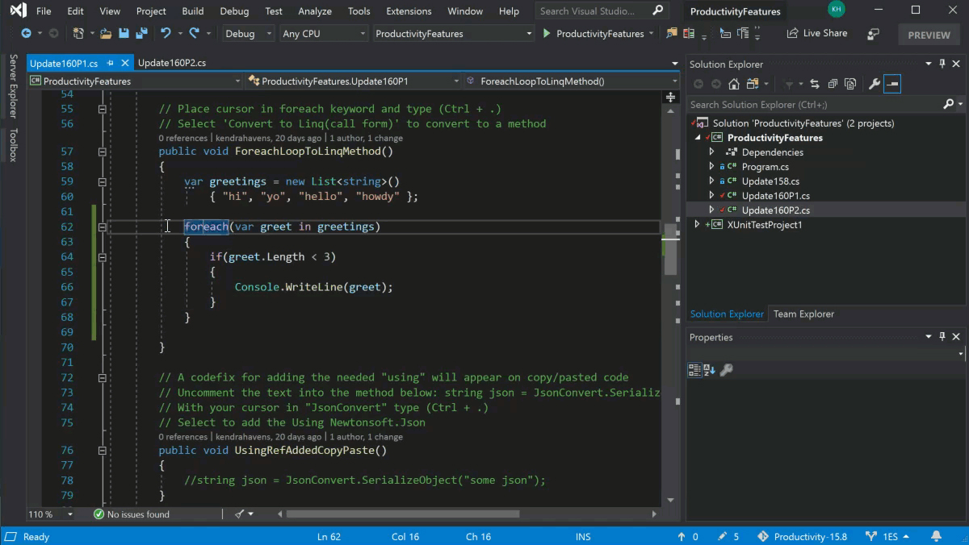
How we did it ?
We used Visual Studio 2019 IDE to develop our computer program

Slide 7



Future plans

Slide 8


